Slide 1
Cancellation status of Hotel Booking by using ML Algorithms
LakshmiarasimhaReddy
119me0011

Slide 2

Agenda
Problem statement
Given data
Visualization
Steps we have done
Chosen Model
Conclusion

Slide 3
Problem statement:
Hotel Booking Cancelation prediction Problem
Binary Classification is the kind. In order to construct the best classification model, data analysis techniques must be learned and applied to the basic problem of hotel reservation cancellation prediction. Given with a dataset that includes information about those who have applied to book a hotel room as well as the approval or denial status. The most precise foundation for a binary classification model needs to be developed.

Slide 4
Data Given:
Number of hotels booking Cancelled (Data Set) and Data types.

Slide 5
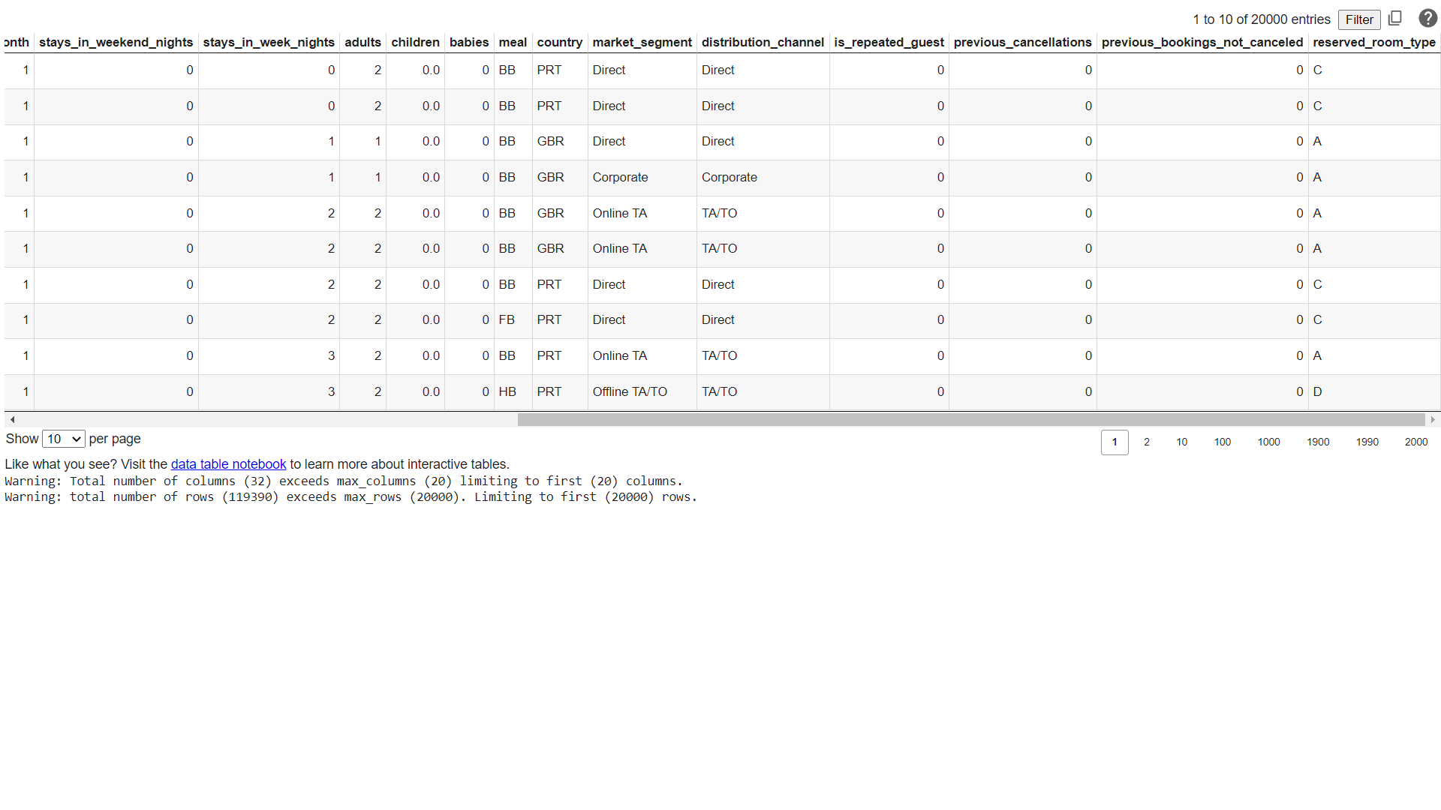
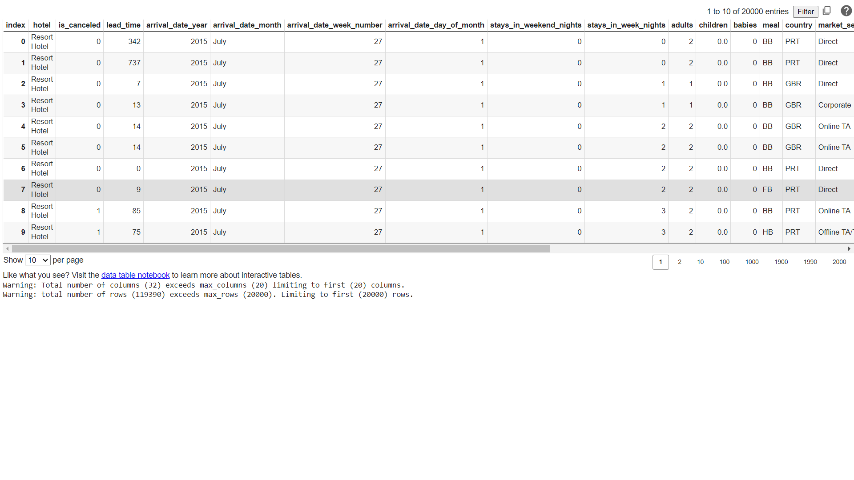
Data set Table:
Link : "https://raw.githubusercontent.com/Premalatha-success/Datasets/main/hotel_bookings.csv"

Slide 6
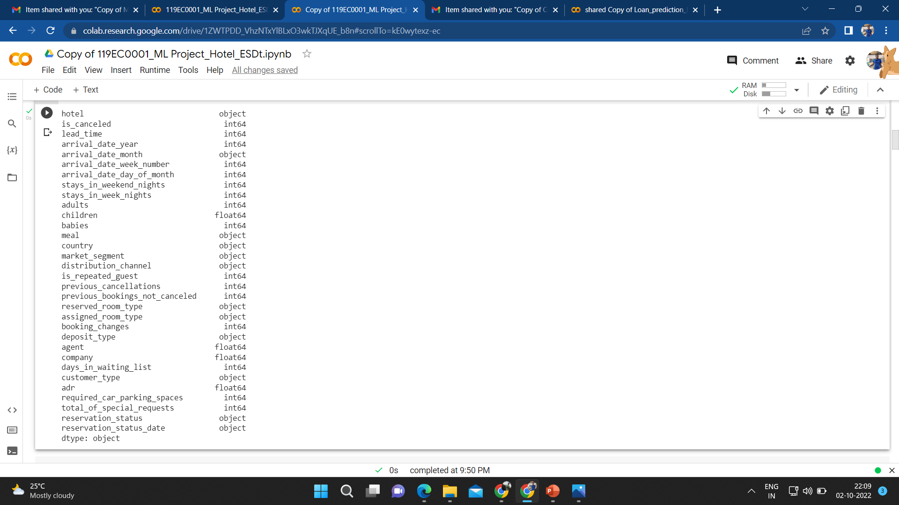
Data Types:

Slide 7
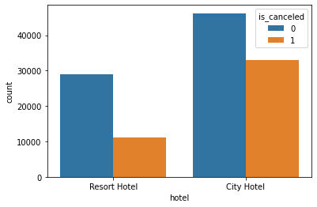
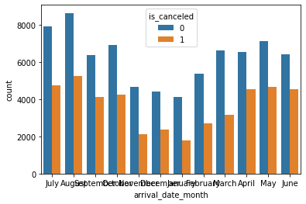
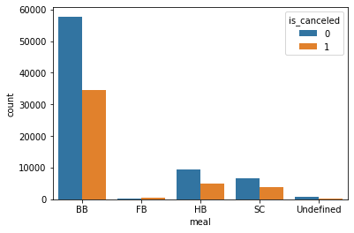
Visualizing feature to feature:

Slide 8
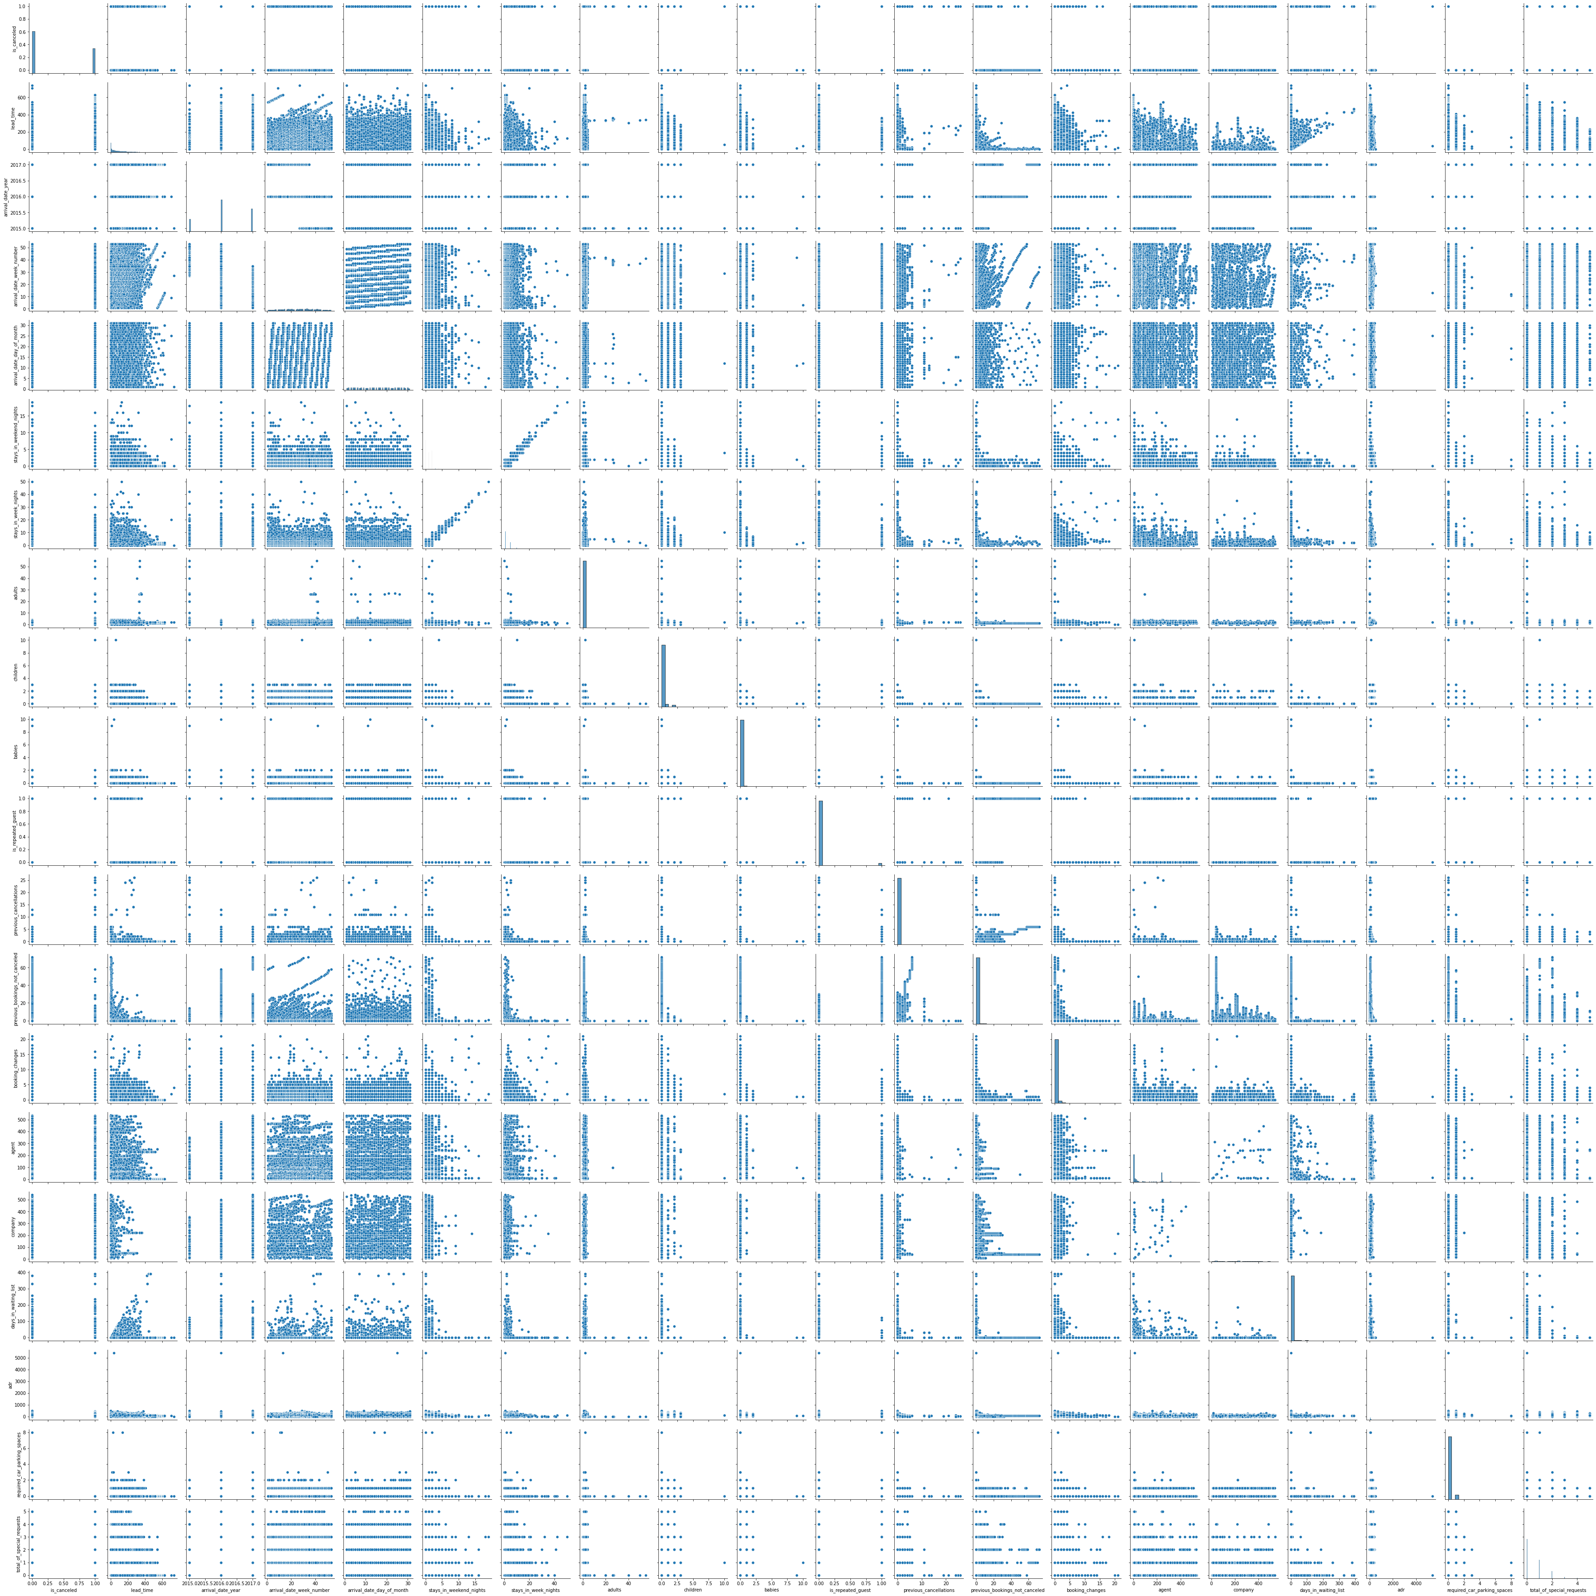
The Pair Plot:

Slide 9
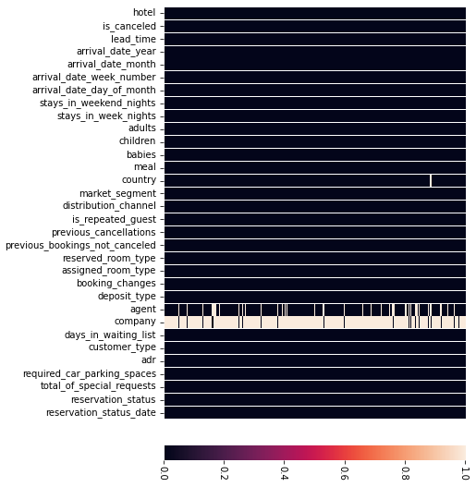
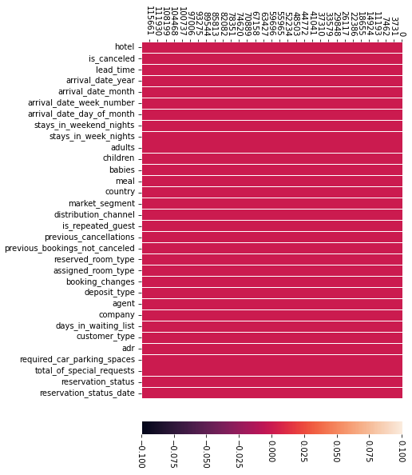
visualizing null values:
Replaced Null values with median for int and float and mode for object type.

Slide 10
Chosen Model: Decision Tree
Why?
Here, I tested three machine learning algorithms, including decision trees, K-Nearest Neighbors, and logistic regression..
I evaluated decision trees, K-Nearest Neighbors, and logistic regression as three machine learning methods here.

Slide 11
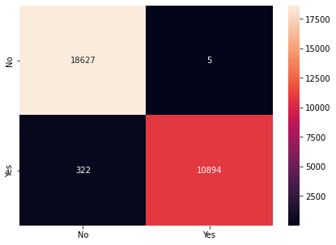
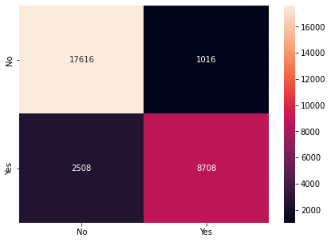
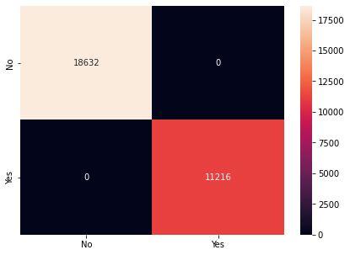
Confusion Matrices of Algorithms:
Logistic Regression
K-Nearest Neighbors
Decision Tree

Slide 12
Conclusion:
Three machine learning classification techniques were employed in this study to determine the status of hotel room cancellations using the provided data set.
After the visualization of features in the data set by using training data and testing data we come to know among the three algorithms the accuracy rate & precision is different they are –
Logistic regression:
Training Data: 0.9899823546492149
Testing data:0.9890444920932726
KNN:
Training Data:0.9209979674342766
Testing data:0.881935138032699
Decision Tree:
Training Data: 1.0
Testing Data: 1.0
So, we come to know that Decision Tree model classifier is working more accurate in booking of services from Hotel.

Slide 13
Thank you

